Slide 1


Lecture 4
Cell annotation and markers
Micah Fletcher, PhD
Bioinformatics Analyst
ENPRC Genomics Core

Slide 2
What have we done so far and what comes next?

Slide 3
What have we done so far and what comes next?
Sample prep and sequencing
Lecture 2
Sample prep
Cell capture
Sequencing
UMI count table(s)

Slide 4
What have we done so far and what comes next?
Sample prep and sequencing
Lecture 2
Sample prep
Cell capture
Sequencing
Single-sample scRNA-seq
Lecture 3
UMI count table(s)
Dimensionality reduction
Cell clustering
QC/processing

Slide 5
What have we done so far and what comes next?
Sample prep and sequencing
Lecture 2
Sample prep
Cell capture
Sequencing
Single-sample scRNA-seq
Lecture 3
Lecture 4
UMI count table(s)
Finding markers
Dimensionality reduction
Cell clustering
QC/processing
Cell type annotation

Slide 6
Goals for today
Be familiar with the main approaches to cell type annotation, their pros and cons
Marker-based annotation
a priori markers
de novo markers
Reference-based annotation
Cell-by-cell signature comparison
Projection/integration
Understand a typical cell annotation workflow, including best practices and where things can go wrong
Apply various tools to find markers and identify cell types in the Kang et al. dataset using R

Slide 7
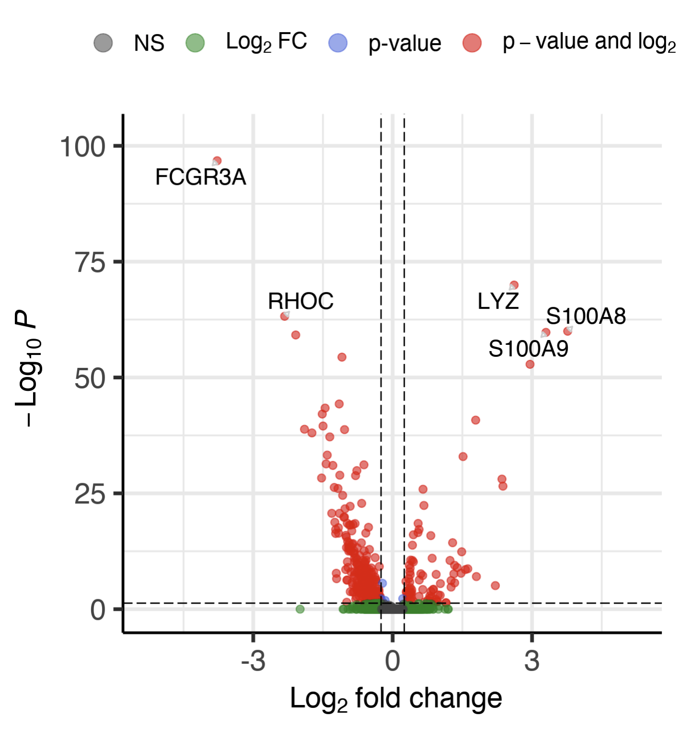
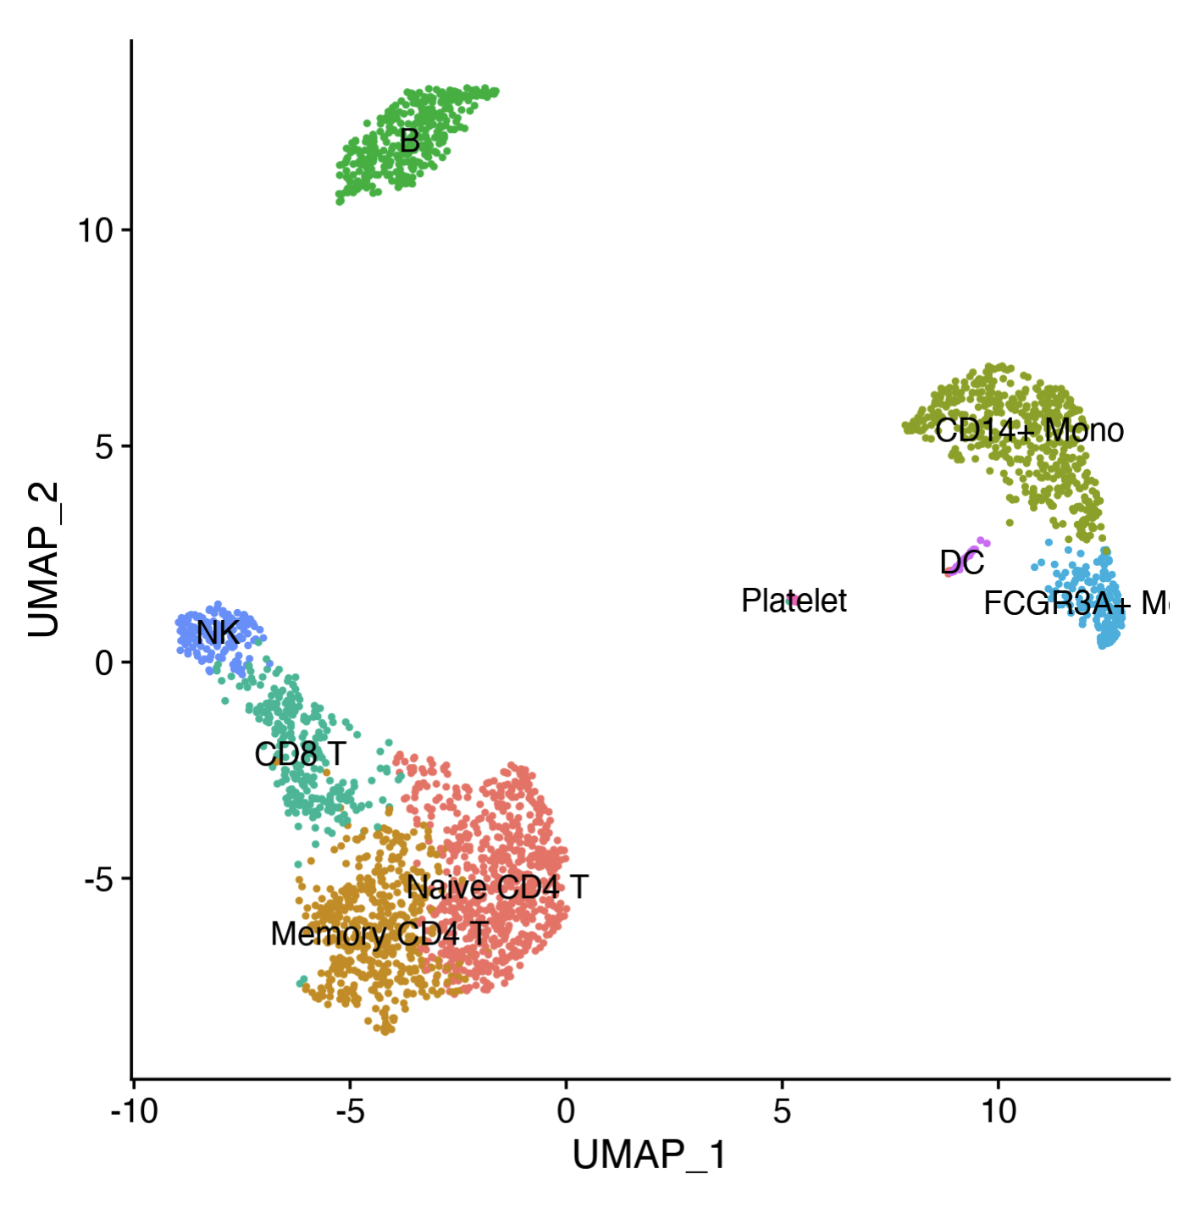
Marker-based annotation: what are markers?
Differentially expressed genes upregulated in a focal cell type relative to other cell types
[Image of volcano plot]

Slide 8
Marker-based annotation: what are markers?
Differentially expressed genes upregulated in a focal cell type relative to other cell types
Two flavors: pairwise and one-vs-all

Slide 9
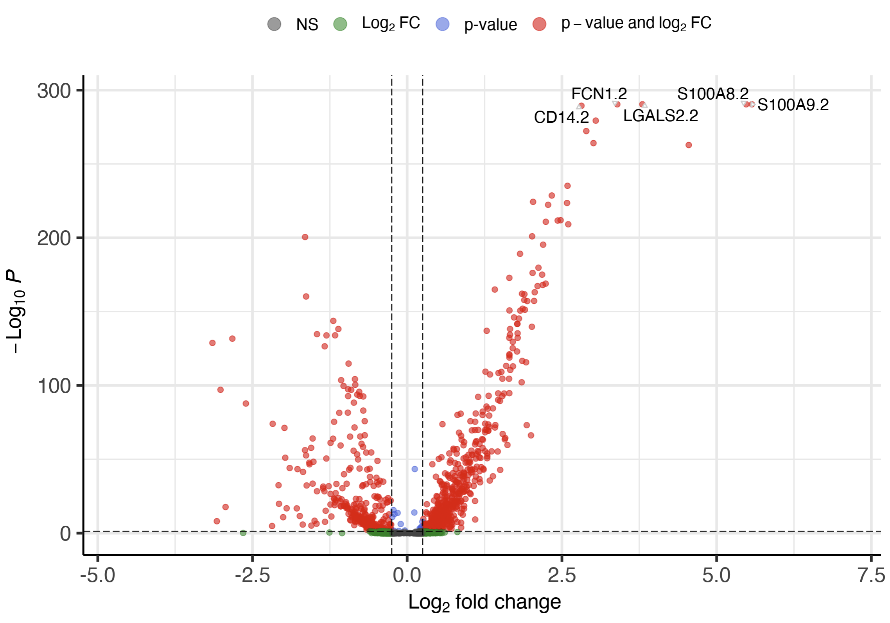
Marker-based annotation: what are markers?
Differentially expressed genes upregulated in a focal cell type relative to other cell types
Two flavors: pairwise and one-vs-all

Slide 10
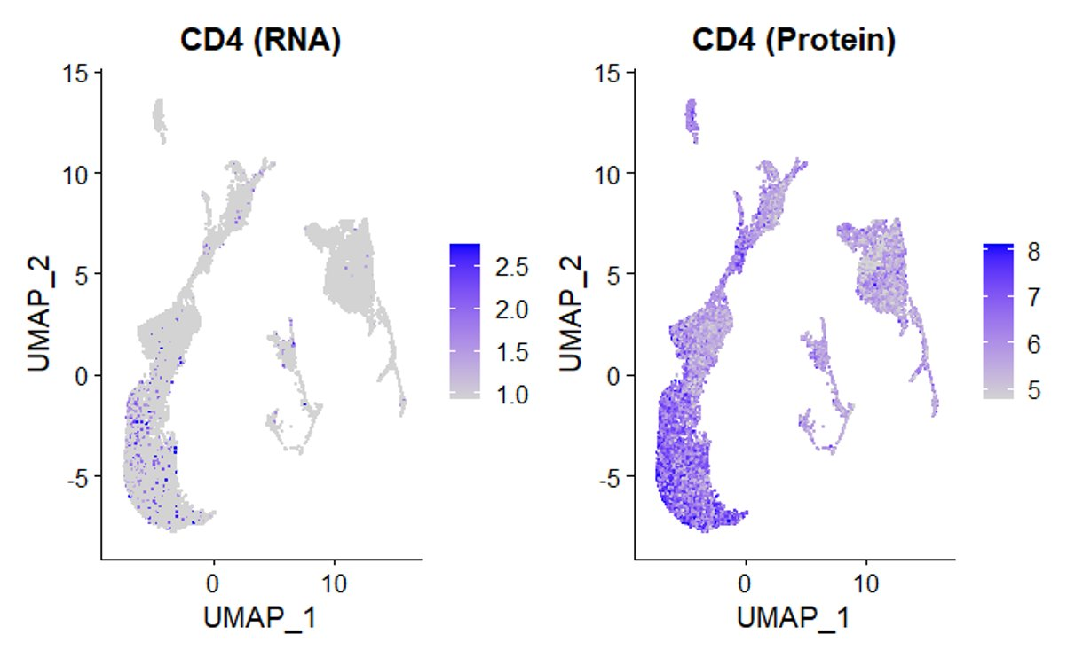
a priori markers
Expression of individual a priori markers or sets of markers
Derived from the literature
Always empirically derived; must take into account
biological and experimental context and
study quality / statistical rigor
CAUTION: scRNAseq ≠ flow cytometry!
Drop out
One or a few markers often not sufficient
RNA ≠ Surface protein

Slide 11
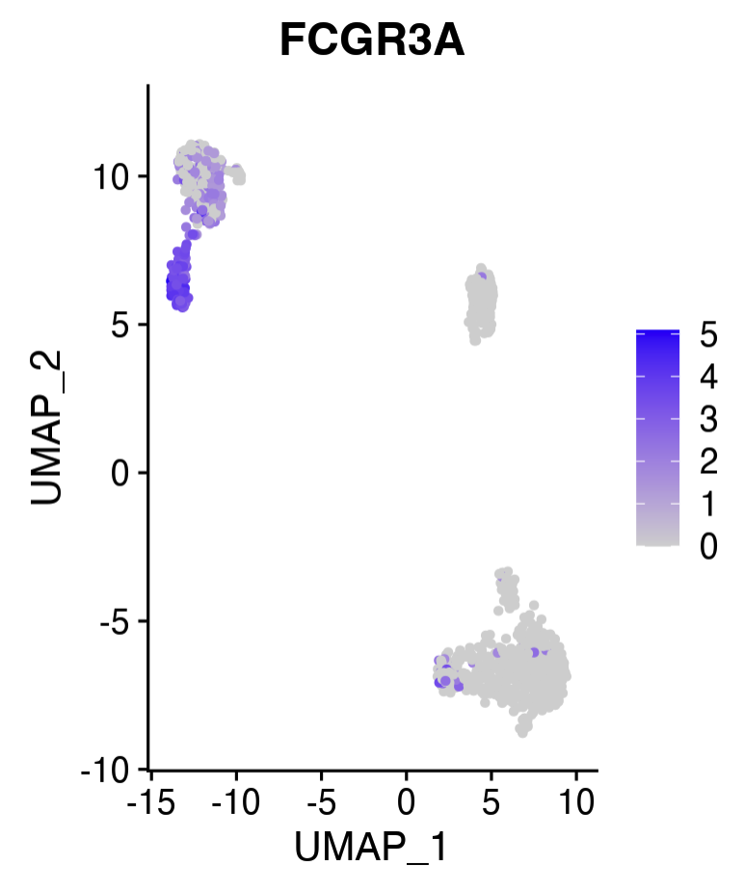
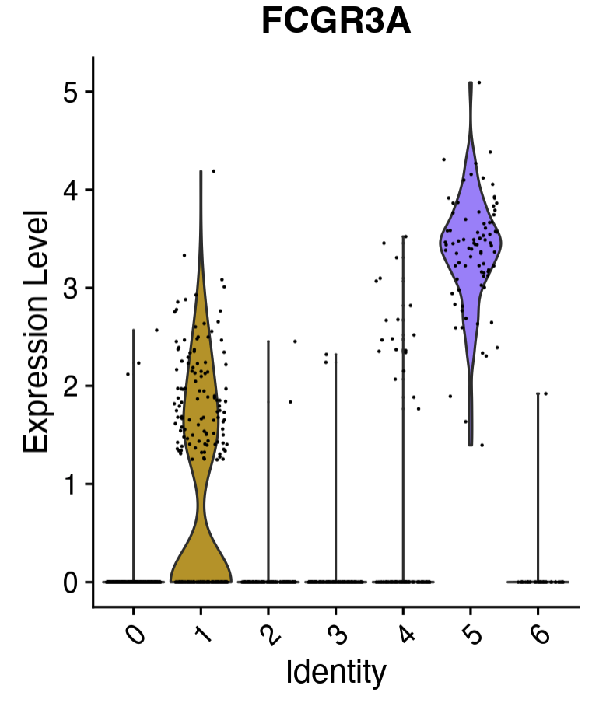
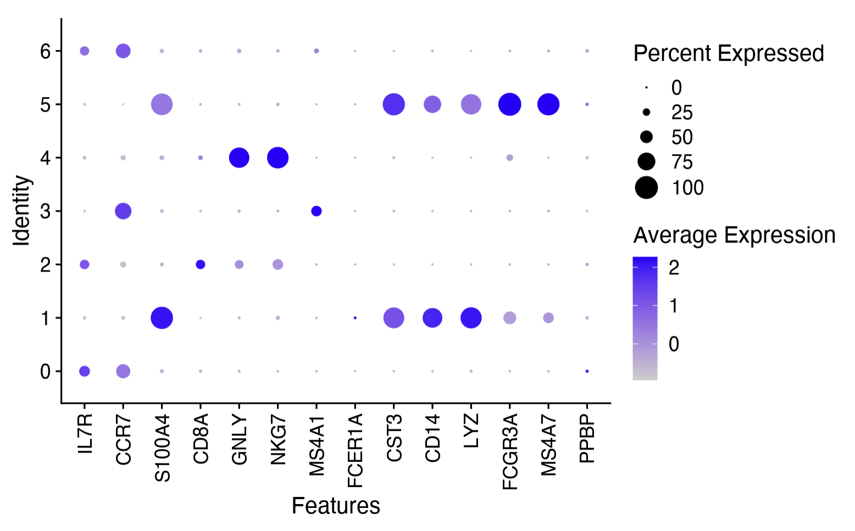
a priori markers – evaluating individual markers
Single cells
Groups of cells
Seurat::FeaturePlot()
Seurat::VlnPlot()
Seurat::DotPlot()
Expression in UMAP space
Expression as violin plots
Expression as a dot plot

Slide 12
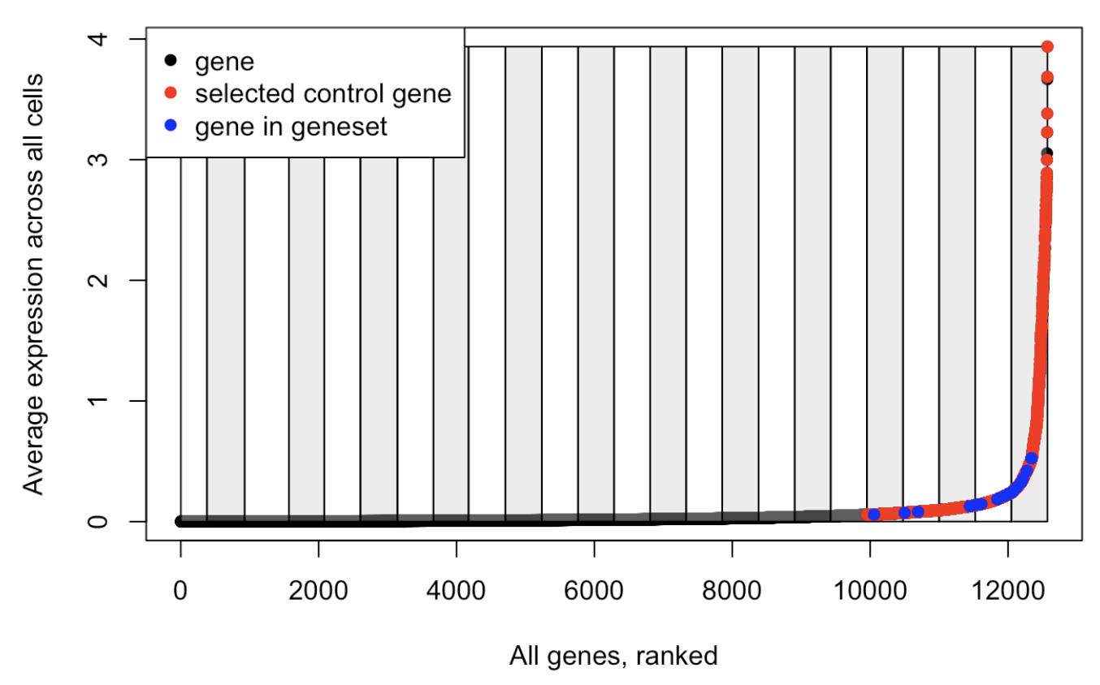
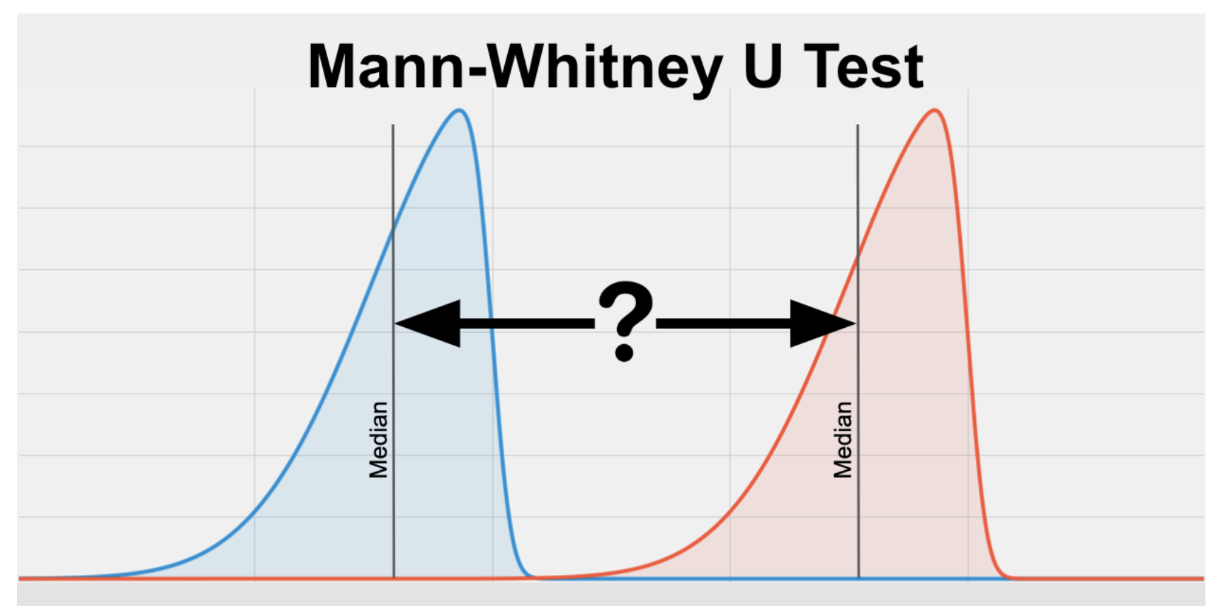
a priori markers – evaluating sets of markers
Often referred to as gene “modules”
Seurat::AddModuleScore()
Ucell::Ucell_AddModuleScore()
Normalized expression relative to average expression of a control set of genes across the whole dataset
Score for an individual cell depends on the expression of other cells in the dataset
Score ranges will vary unpredictably across datasets and even cell population subset analyses
Ranks genes within individual cells based on expression levels, then estimates enrichment of that cell’s expression for the marker gene set using a statistic based on Mann-Whitney U
Score will always range from 0 to 1
Preferred, because it does not rely on dataset composition and thus is stable
https://www.waltermuskovic.com/2021/04/15/seurat-s-addmodulescore-function/
https://www.statstest.com/mann-whitney-u-test/

Slide 13
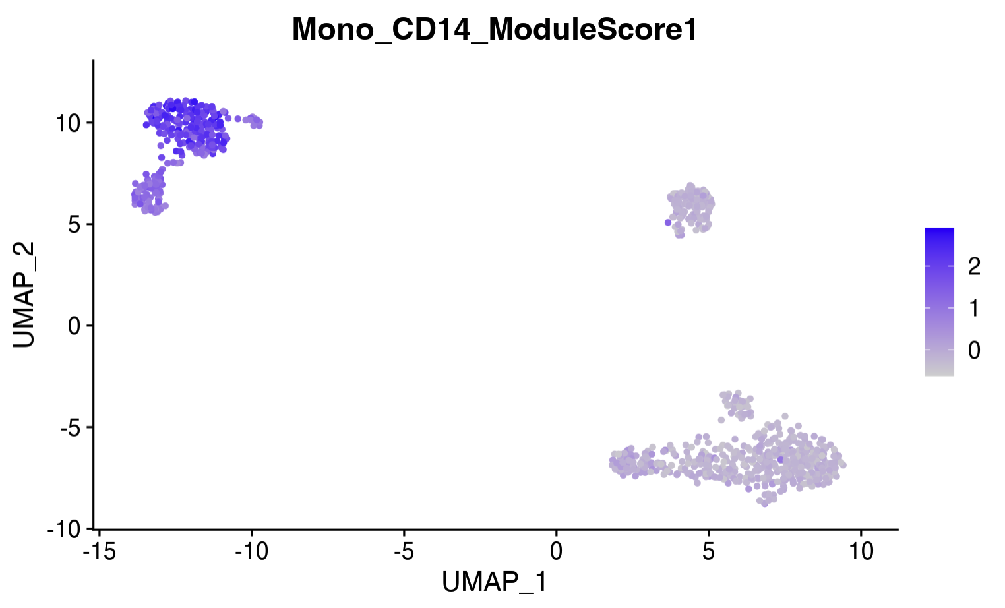
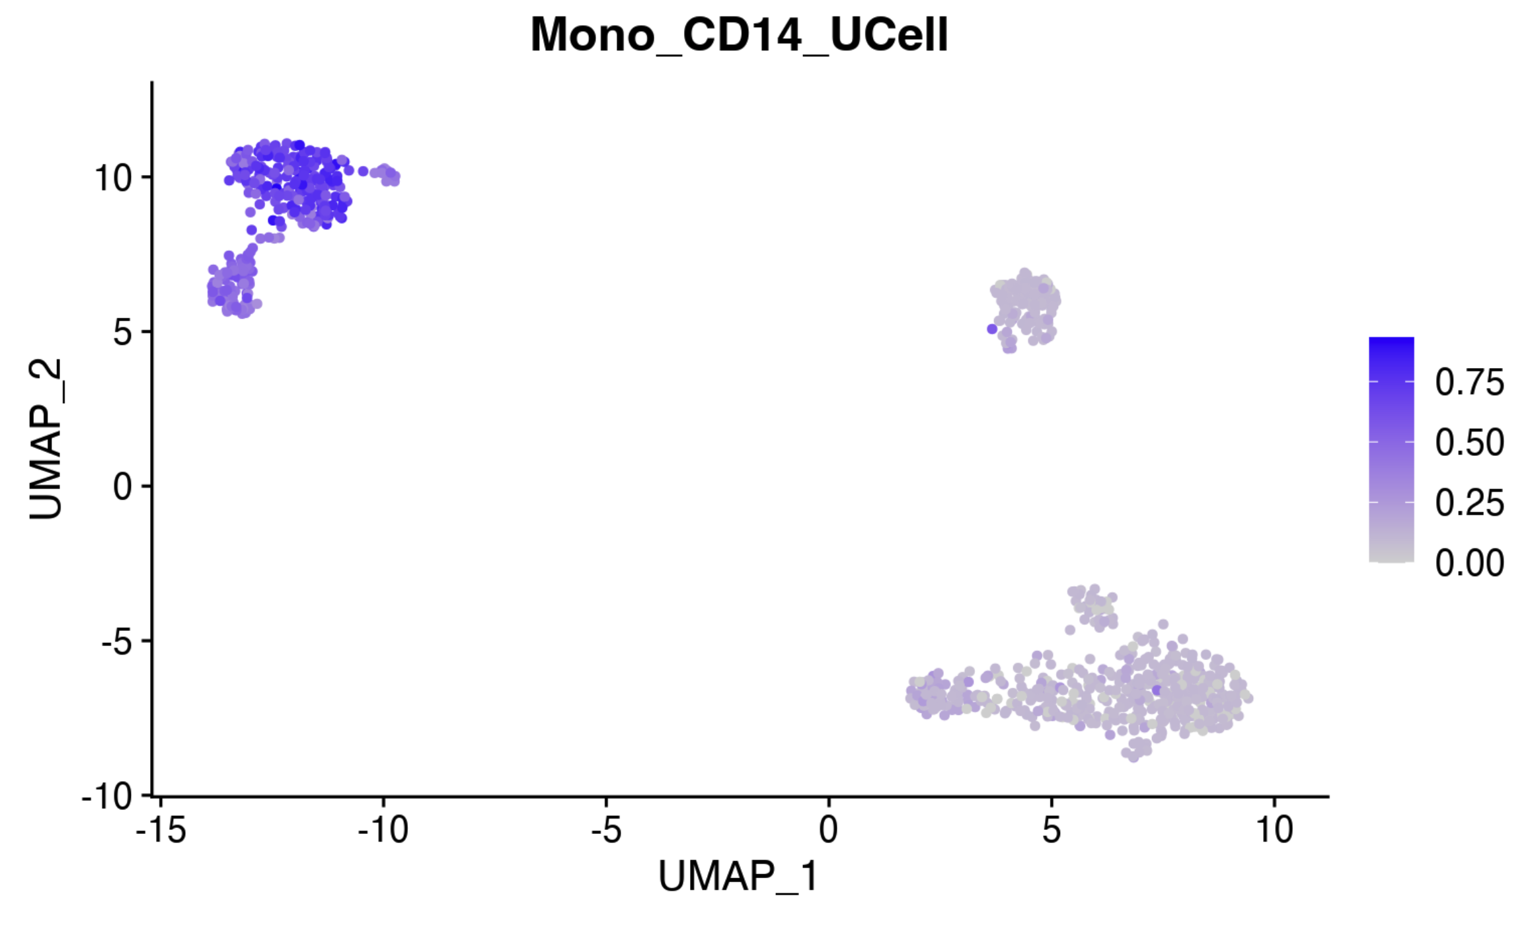
a priori markers – evaluating sets of markers
Often referred to as gene “modules” – can be visualized in the same way as individual markers
Seurat::AddModuleScore()
Ucell::Ucell_AddModuleScore()
Normalized expression relative to average expression of a control set of genes across the whole dataset
Score for an individual cell depends on the expression of other cells in the dataset
Score ranges will vary unpredictably across datasets and even cell population subset analyses
Ranks genes within individual cells based on expression levels, then estimates enrichment of that cell’s expression for the marker gene set using a statistic based on Mann-Whitney U
Score will always range from 0 to 1
Preferred, because it does not rely on dataset composition and thus is stable
[FeaturePlot]
[FeaturePlot]

Slide 14
de novo markers – compute and filter markers
Recall that there are two flavors:
Pairwise – Seurat::FindMarkers()
One-vs-all – Seurat::FindAllMarkers()
Output options:
only.pos = TRUE # only return positive markers
min.pct = 0.25 # minimum percent of cells the gene has non-zero expression in both clusters
logfc.threshold = 0.25 # minimum average log fold change threshold cutoff to return
Statistical options:
test.use = wilcox The default statistical test is a Wilcoxon Rank Sum test. This is fine for simple comparisons. More complex methods tend to be much slower with only marginal (if any) performance gains. See https://www.biorxiv.org/content/10.1101/2022.05.09.490241v1.full for details.
Beware that multiple hypothesis testing and non-independence of genes will drive up False Discovery Rate! It’s helpful to focus on the top n markers, and take the p-value, log fold change, min.pct1, min.pct2 all into account.

Slide 15
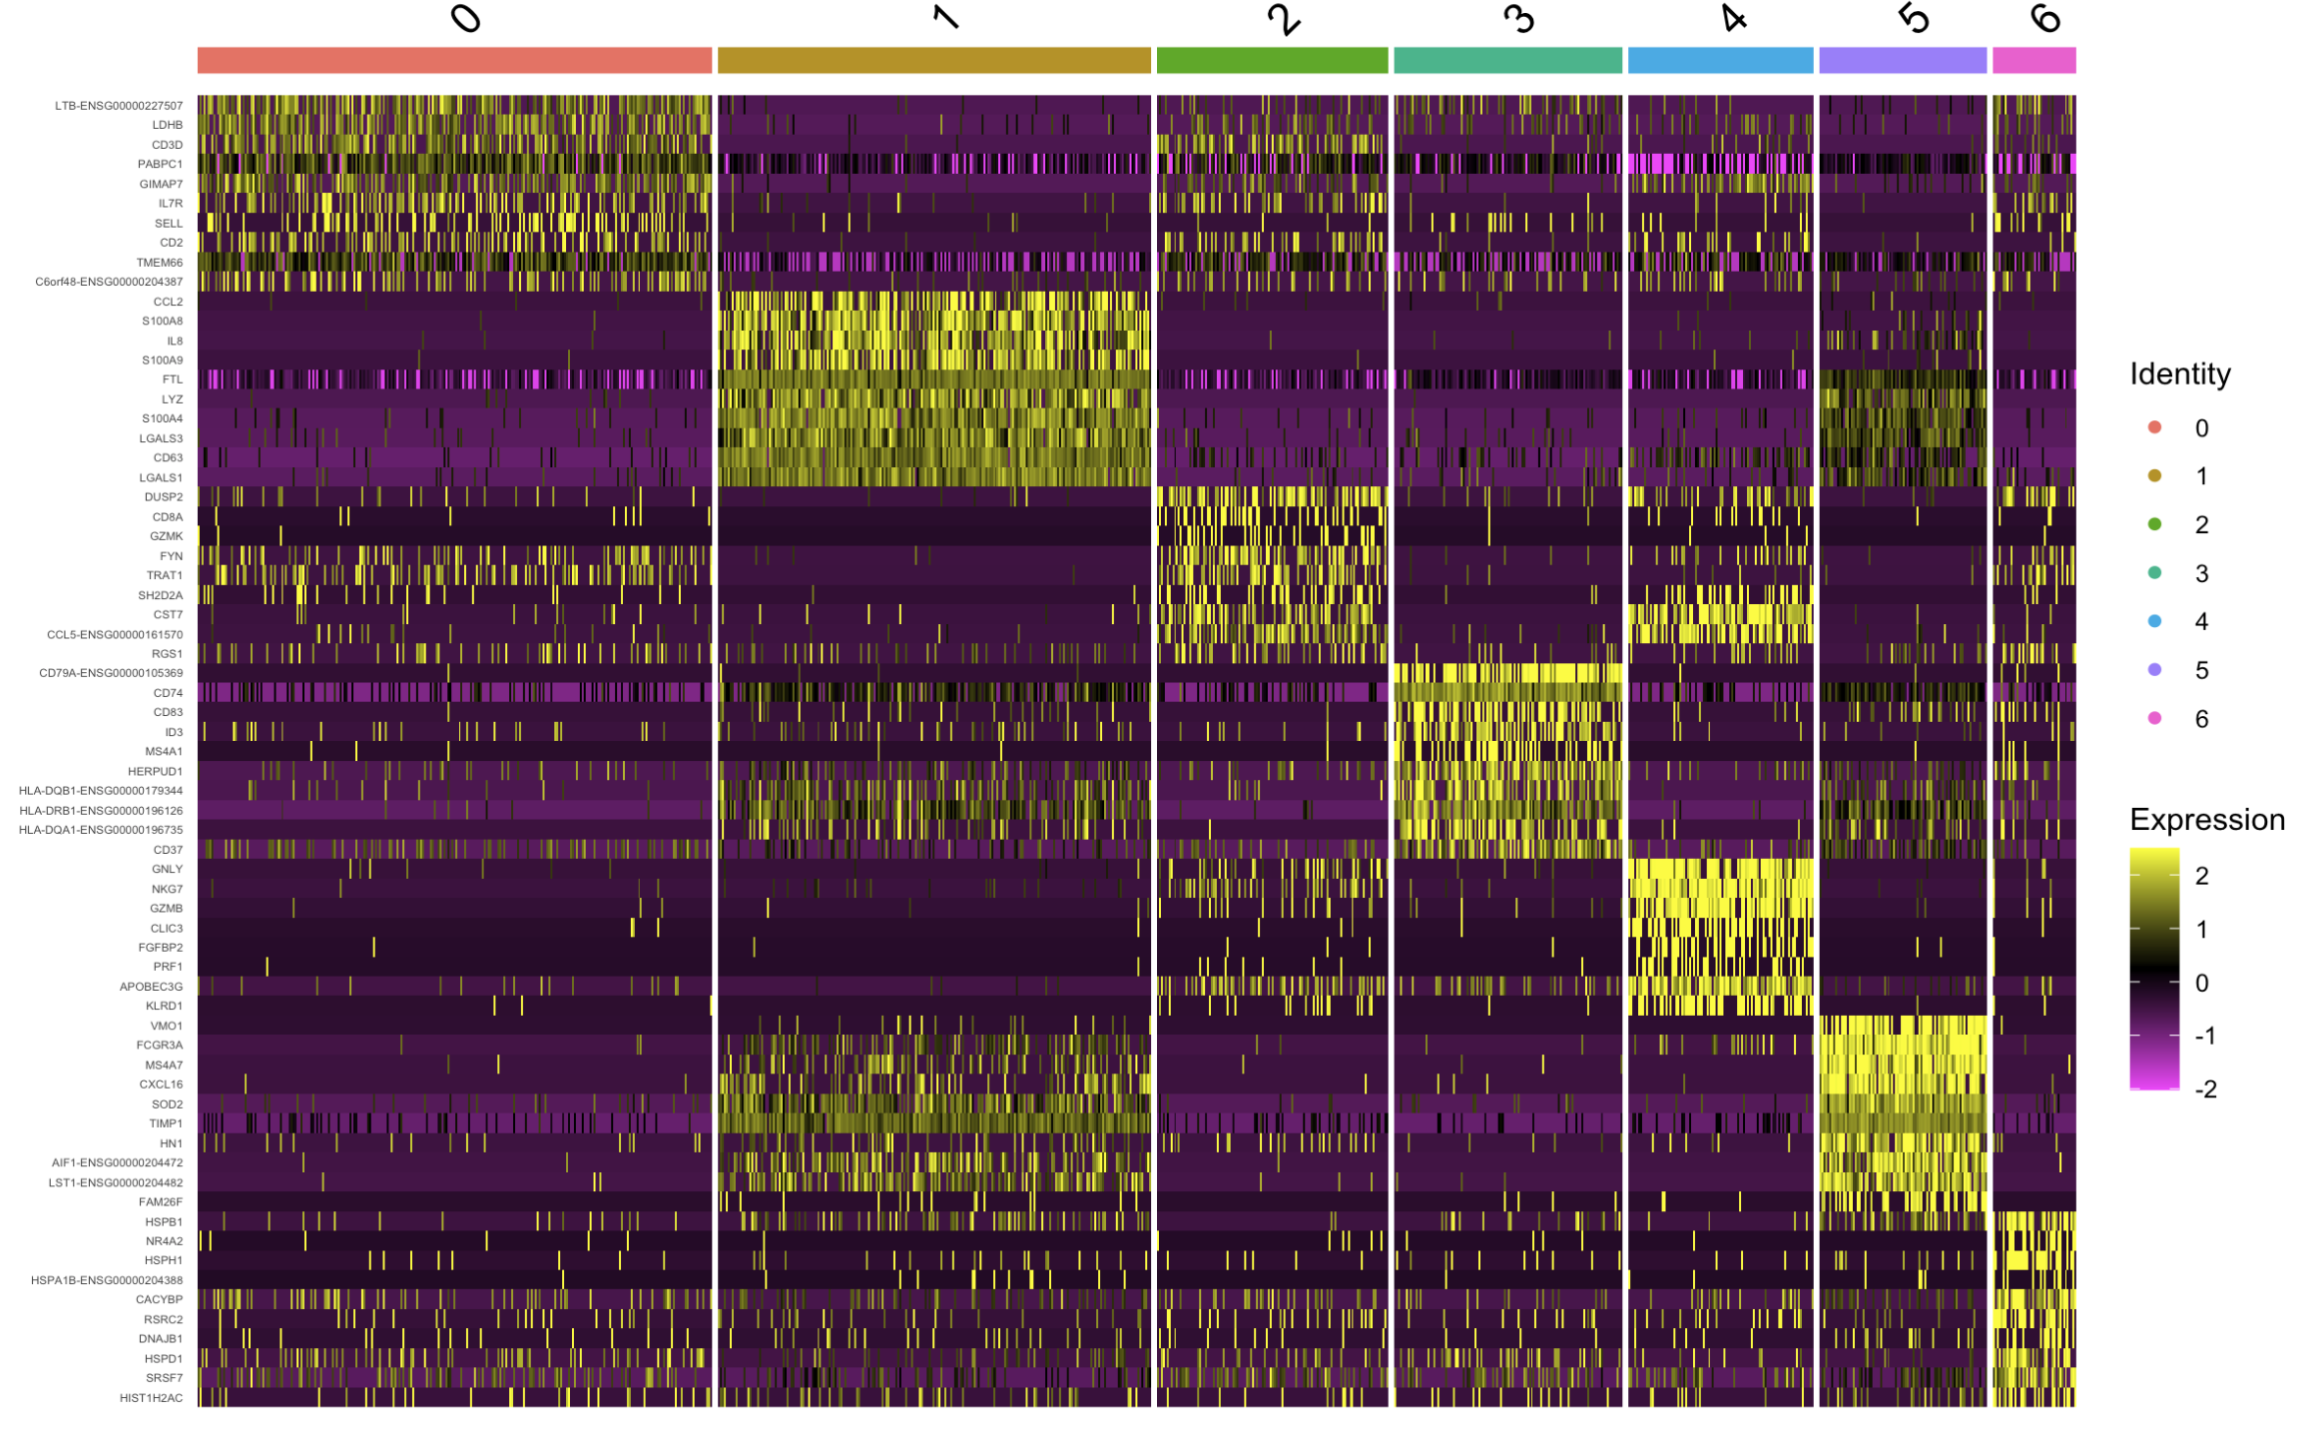
de novo markers – evaluate markers
Perhaps the most useful plot for manually inspecting de novo markers is heatmap
Seurat::DoHeatmap()

Slide 16
Goals for today
Be familiar with the main approaches to cell type annotation, their pros and cons
Marker-based annotation
a priori markers
de novo markers
Reference-based annotation
Cell-by-cell signature comparison
Projection/integration
Understand a typical cell annotation workflow, including best practices and where things can go wrong
Apply various tools to find markers and identify cell types in the Kang et al. dataset using R
See Clarke et al. (Nature Protocols) 2021 for more cell annotation methods

Slide 17
Reference-based annotation: automating annotation using pre-existing data
Many methods available, from simple expression signature correlations to custom machine learning algorithms
Each method typically shares essentially the same broad workflow
Identify a reference dataset
Apply the cell annotation algorithm
Evaluate the accuracy/reliability of the labels
Label unsupervised clusters based on consensus labels

Slide 18
Reference-based annotation: choosing a reference
Predicted labels can only be accurate to the extent that the cell composition of the query matches the reference
Must include the key cell types desired, at least to the granularity required
If more detailed than needed, can always merge labels later
Match query and reference tissue and disease state, if possible
In early stages, it’s usually better to err on the side of a broader, more diverse reference composed of many tissues and/or disease states.
Even if you sorted your captures before sequencing, using broader references helps
identify contamination of non-target cells, and
improve confidence of labels because there are “outgroup” cells that should have very low scores

Slide 19
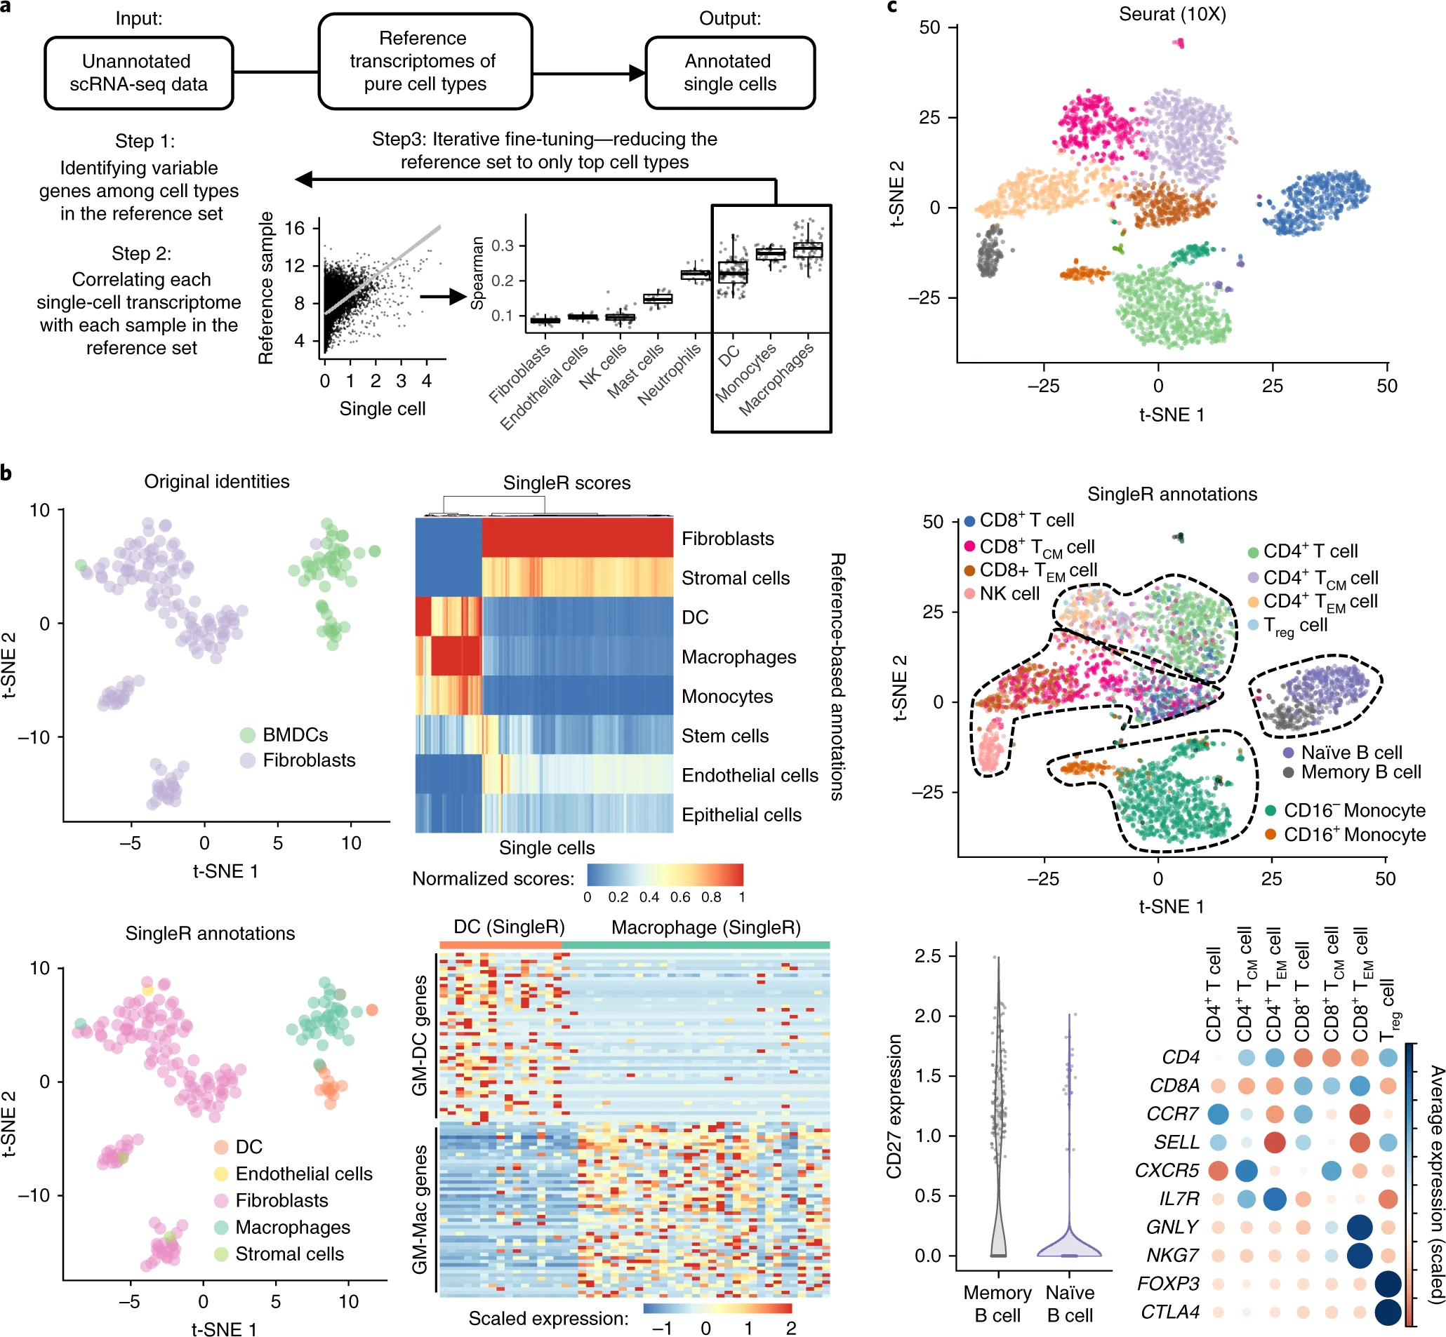
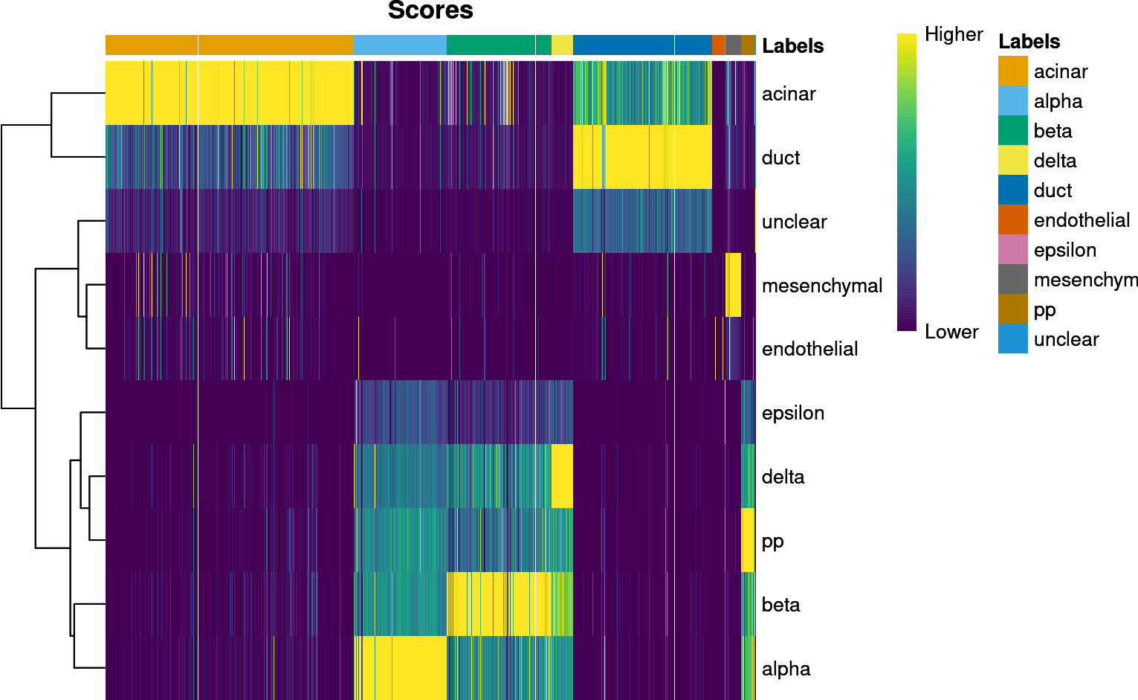
Reference-based annotation: SingleR – algorithm
SingleR – Single cell GEX profile correlation to reference
First, identify markers among labels in the reference.
Then, for each cell:
Compute Spearman correlation between its expression profile and that of each reference sample.
Define the per-label score as a fixed quantile (default = 0.8) of the correlations across all samples with that label.
Repeat score calculation for all reference labels. Highest scoring label = SingleR’s prediction
(Optional) Reduce reference to only top scoring cell types and recompute score. Iterate until only label remains.
Ref. labels
Ref. markers
Ref. samples
Adapted from Aran et al. (Nature Immunology) 2019
See https://bioconductor.org/books/release/SingleRBook/ for detailed tutorial

Slide 20
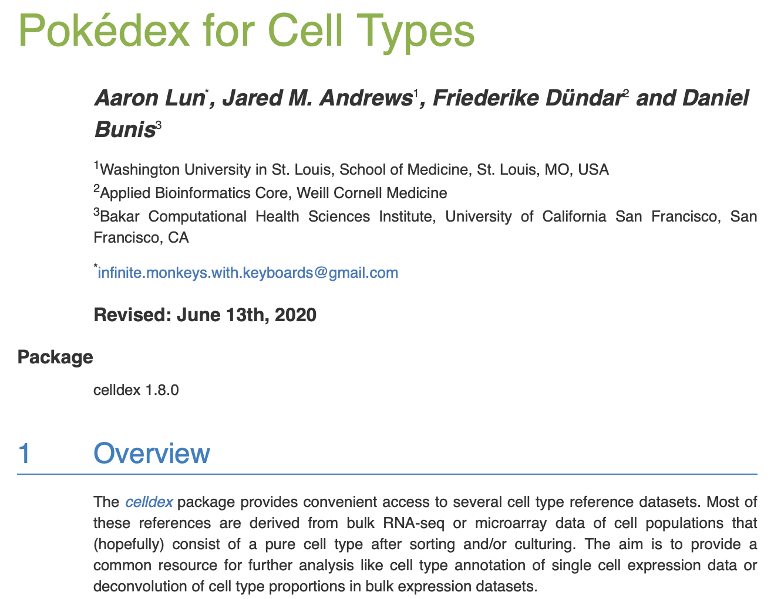
Reference-based annotation: SingleR – choosing a reference
SingleR uses data package celldex to host its “built-in” references
Each reference comes from different sources, and have different pros and cons.
Each reference will have three levels of cell type annotation in the metadata
label.main – broadest human-readable labels
label.fine – finest human-readable labels
label.ont – fine-grained standard Cell Ontology database codes (see SingleR book for details)
Run browseVignettes("celldex") in the R console and view the html summary for details.
https://bioconductor.org/packages/devel/data/experiment/html/celldex.html

Slide 21
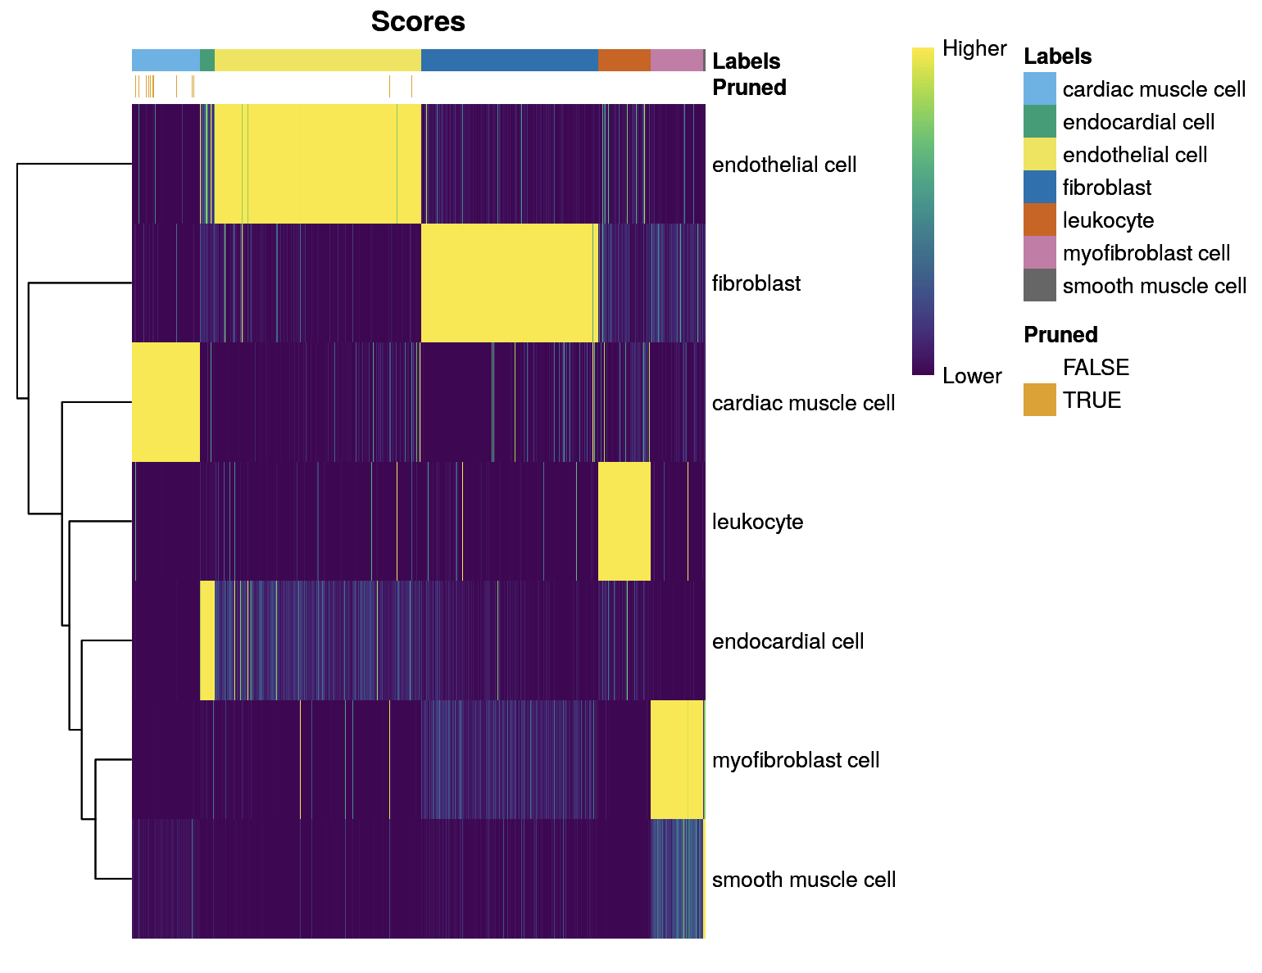
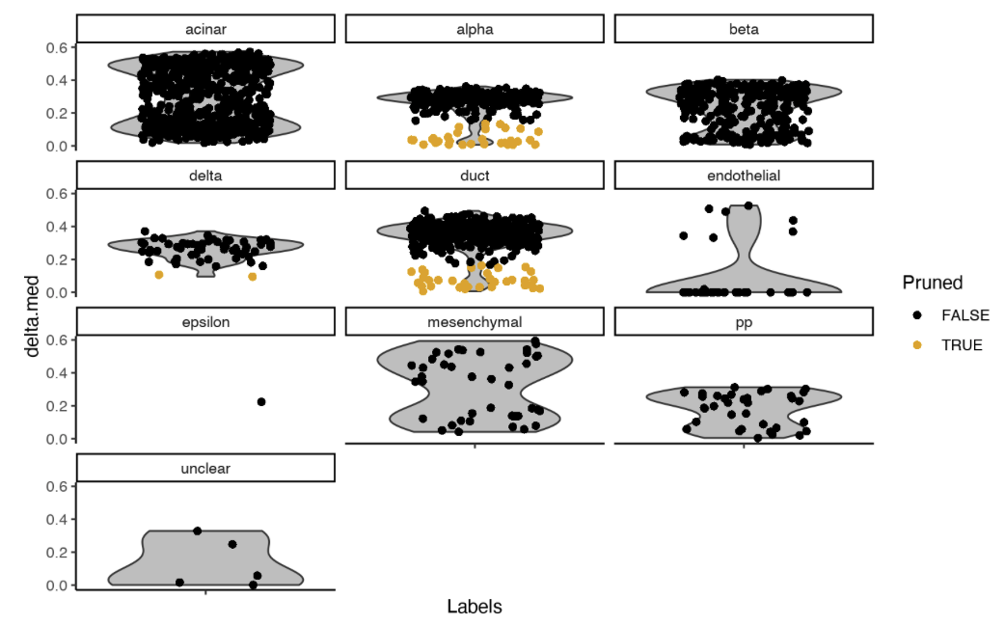
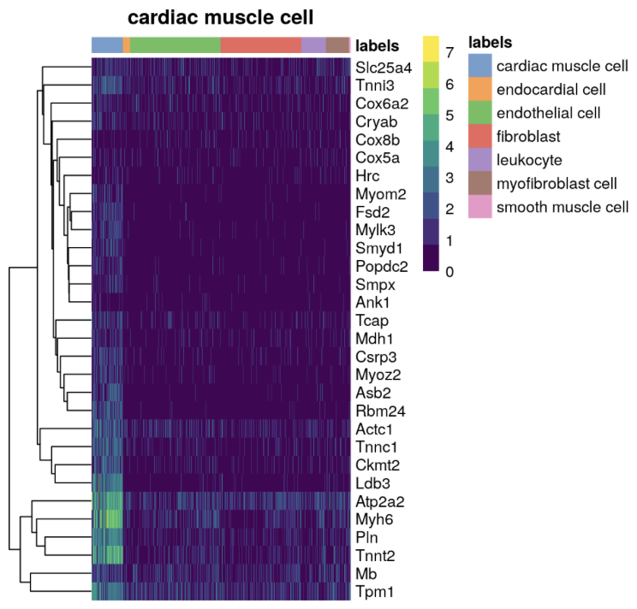
Reference-based annotation: SingleR – evaluating performance
plotScoreHeatmap()
plotDeltaDistribution()
Reference marker heatmap
(see coding session)
See browseVignettes(“SingleR”)

Slide 22
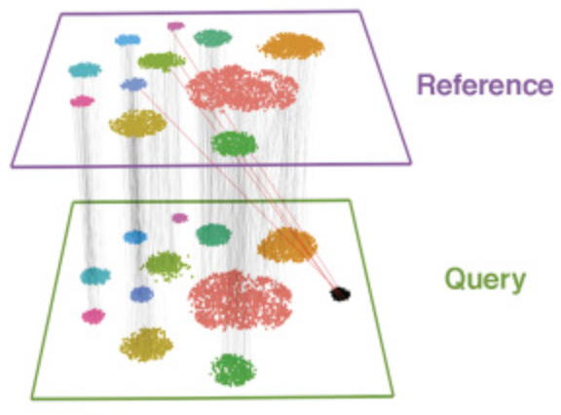
Reference-based annotation: Azimuth
Azimuth is a web-based tool from the Seurat team that:
”integrates” (more on this next lecture) your data with an existing curated dataset, then
transfers labels from the existing dataset to your data based the neighborhood of nearby labeled cells
Azimuth provides confidence scores for assessing cell table quality.
Stuart et al. (2019) Cell

Slide 23
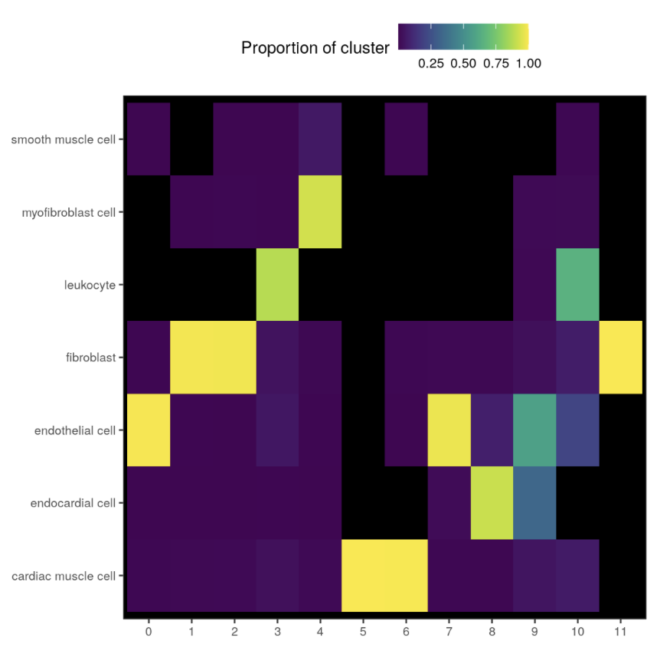
Reference-based annotation: Assigning labels to clusters
It is generally wiser to assign all cells to the consensus label for that cluster, rather than keeping the single-cell automated labels.
Sometimes that means a cluster cannot be reliably labeled, or that further investigation is required.
One helpful visualization of consensus labels is a cluster-label heatmap:
Proportion of cells
given each label (y-axis)
in each cluster (x-axis)

Slide 24
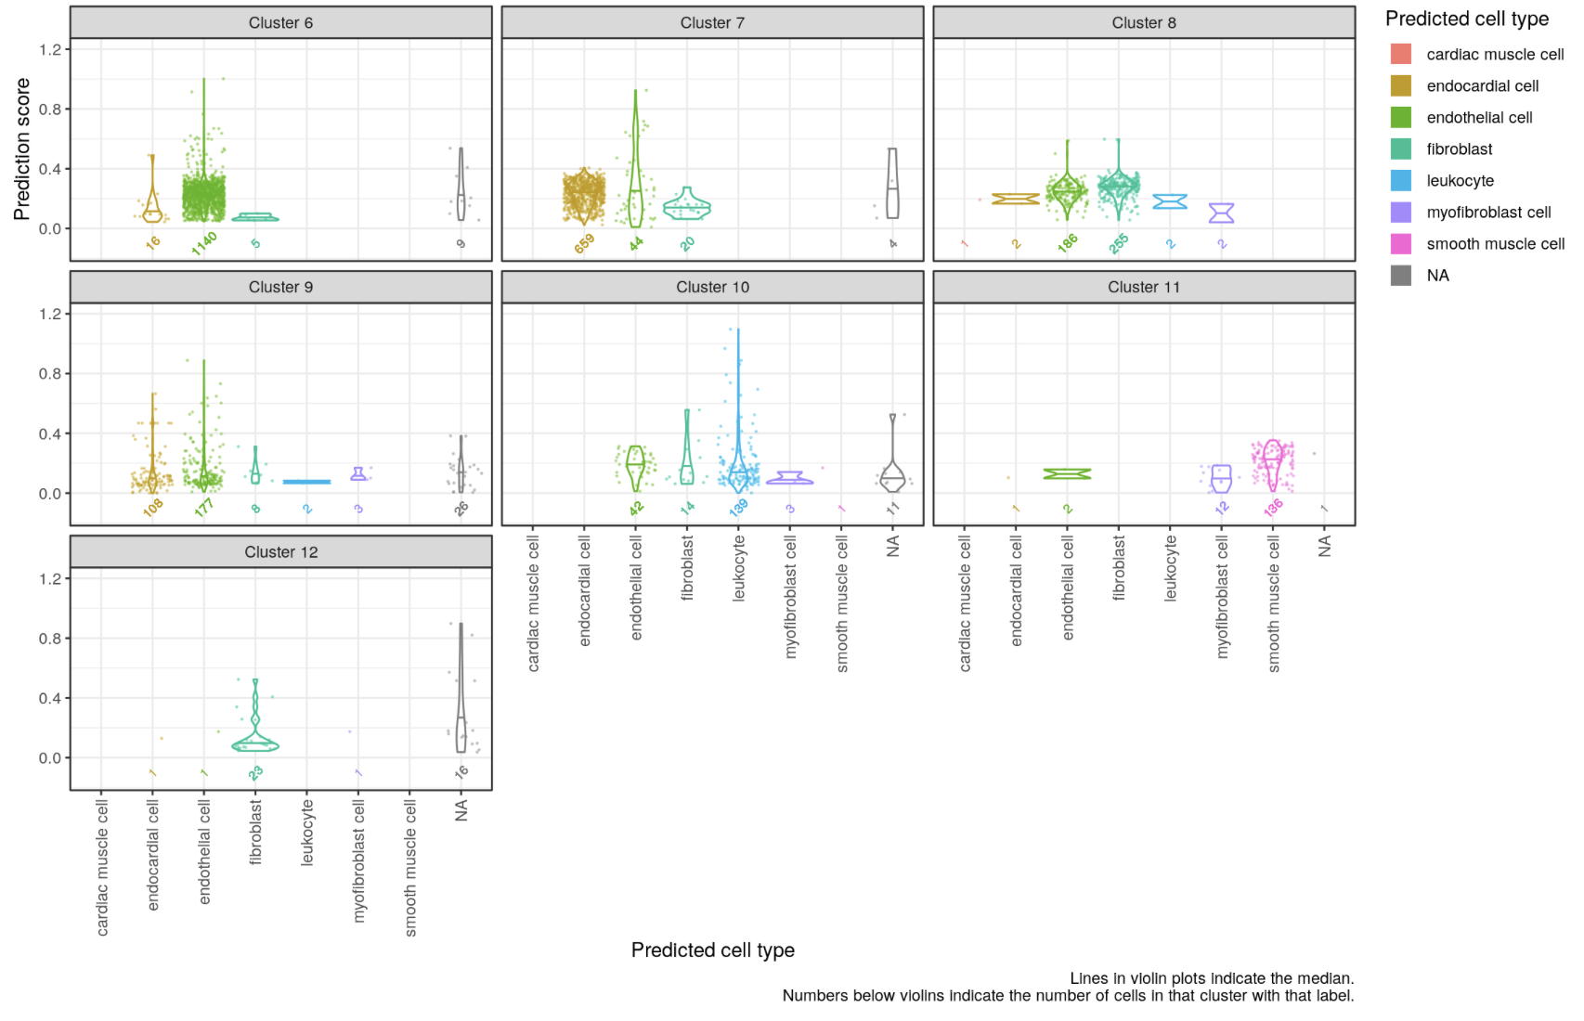
Reference-based annotation: Assigning labels to clusters
It can also be helpful to plot the annotation scores of each cell, divided into their constituent clusters in a facetted violin score plot:
Each cell’s
prediction score (y-axis),
for each label (x-axis)
for each cluster (facets)

Slide 25
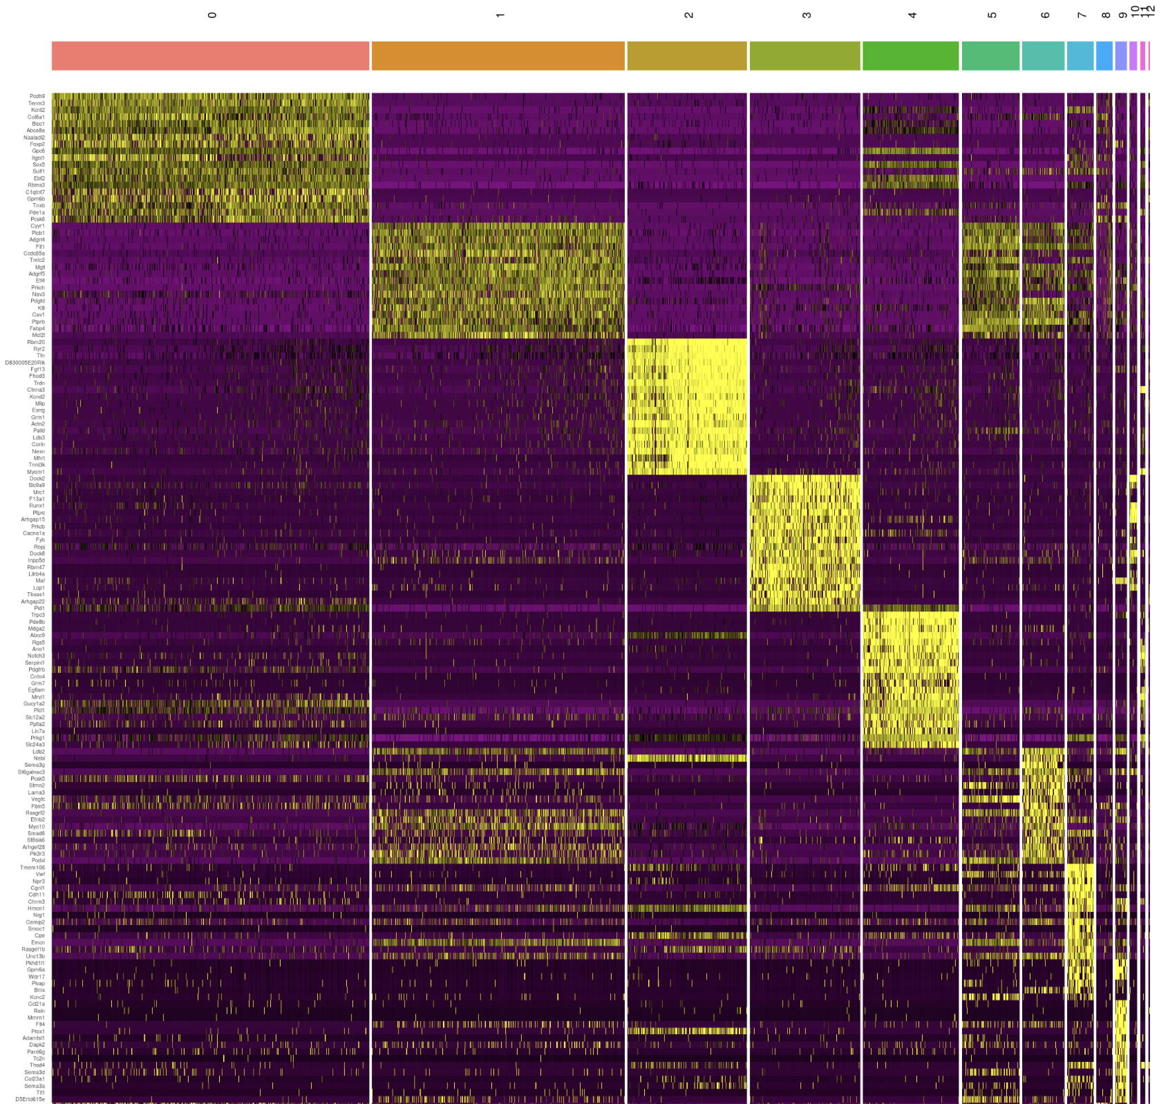
Reference-based annotation: Assigning labels to clusters
Regardless of the methods used to acquire cluster labels, ALWAYS compute de novo markers and check thoroughly that they make sense!

Slide 26
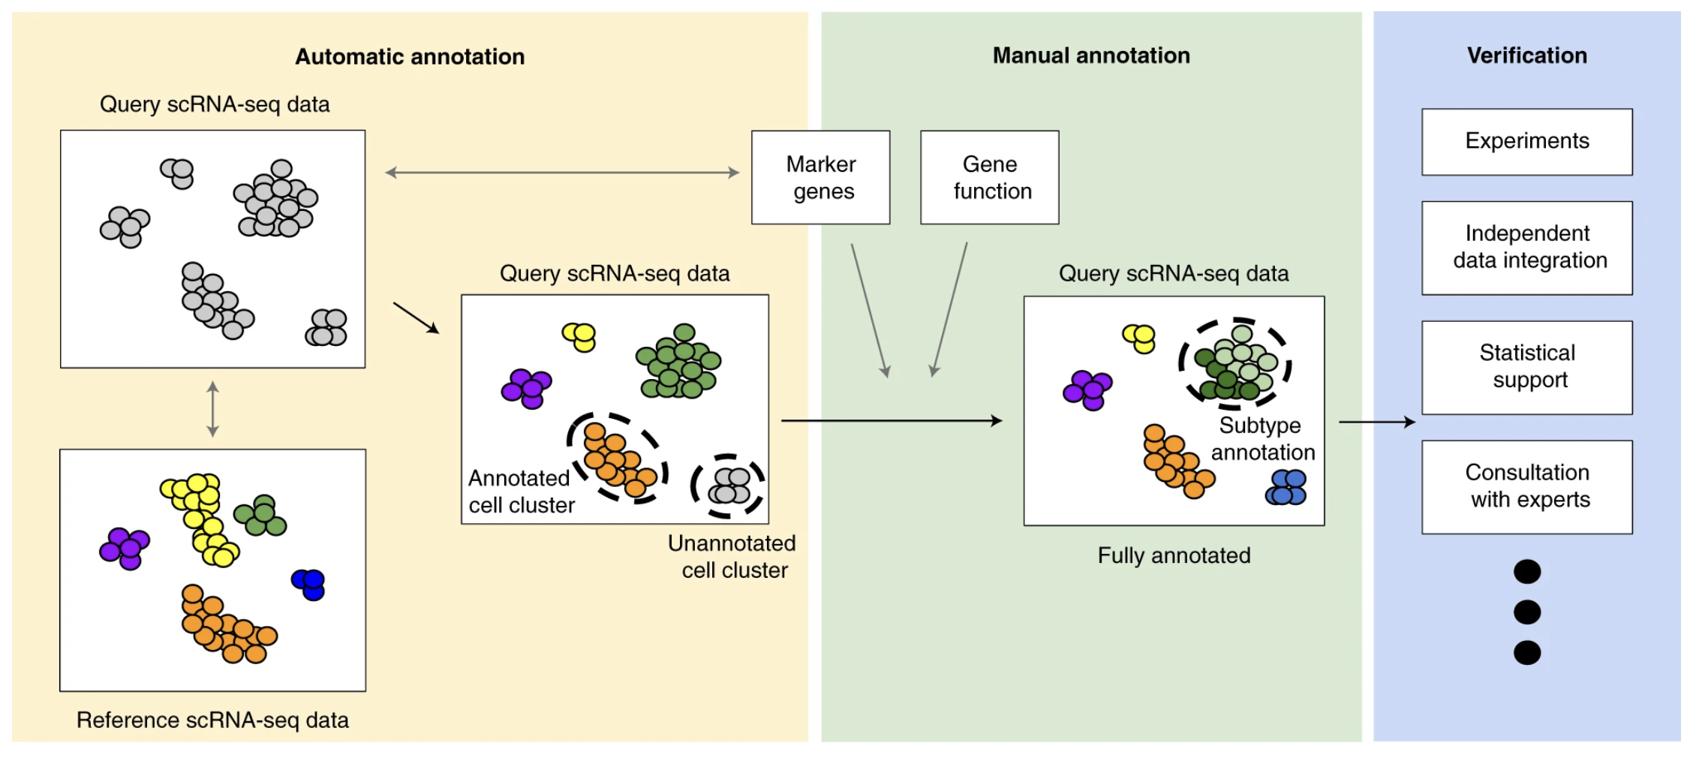
Reference-based annotation: Assigning labels to clusters
Clarke et al. (2021) Nature Protocols
Notes:
add citation to this slide

Slide 27
Cell annotation: review of best practices
Gene dropout and poor correspondence between surface protein and RNA mean that “canonical” markers from anti-body staining / flow cytometry studies may not work well on scRNA-seq data
Future lecture: CITE-seq can dramatically improve labeling of certain cell types (e.g. CD4 vs. CD8 T cells)
Examining module profiles sometimes helps circumvent the problem of dropout and sometimes make visualizations more digestible.
Use consensus labels for each unsupervised cluster rather than using single-cell-based labels.
Reference-based annotation results depend heavily on the quality and composition of the reference.
Automated methods are often a good first step, but must be validated rigorously.
Regardless of the method used, it's always essential to have a domain expert (i.e. probably you, not a bioinformatician) thoroughly inspect the de novo marker genes for each cluster before finalizing labels.

Slide 28
Goals for today
Be familiar with the main approaches to cell type annotation, their pros and cons
Marker-based annotation
a priori markers
de novo markers
Reference-based annotation
Cell-by-cell signature comparison
Projection/integration
Understand a typical cell annotation workflow, including best practices and where things can go wrong
Apply various tools to find markers and identify cell types in the Kang et al. dataset using R

